Slide 1


SENTIMENTPULSE
LIVE
By Team Spirit

Slide 2
TABLE OF CONTENTS
01
05
02
06
03
07
04
08
Team Member Roles and Responsibilities
Personas
Improvements
MVP
Project Description
Technologies
Team Working Agreement
Algorithms

Slide 3
TABLE OF CONTENTS
09
13
10
14
11
15
12
16
Diagrams
Retrospective
Product Backlog
Sprint 2
Sprint 1 Backlog
Project Demo
Metrics
WikiPage Link and Live Demo

Slide 4



Team Member Roles and Responsibilities
Sandhya Reddy Kallem
Yashwanth Thalla
Dhruv Maheshbhai Ranpariya
Frontend developer
Backend Developer
Frontend Developer

Slide 5


Team Member Roles and Responsibilities
Hema Durga Prasad Chittala
Sravan Kumar Ganji
Backend Developer
Machine Learning Enginner

Slide 6
Improvements
Changing Team Agreement
Retrospective action items
Github icons proper align inside wikipage

Slide 7
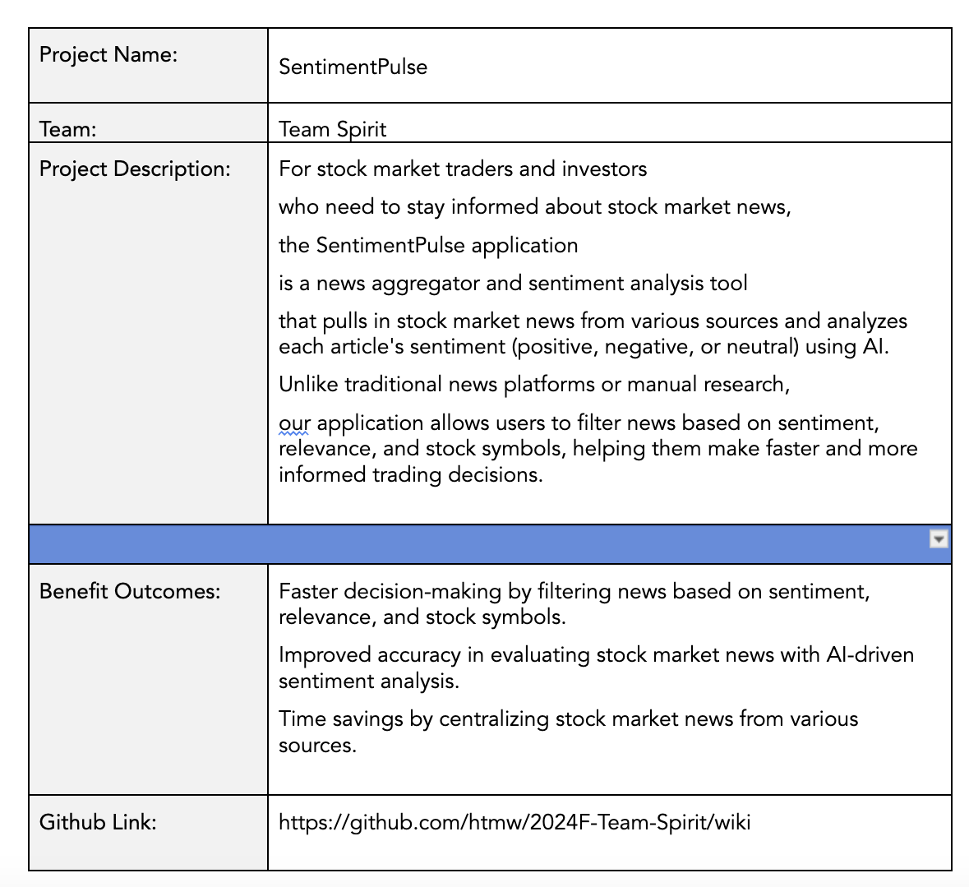
Project Description

Slide 8
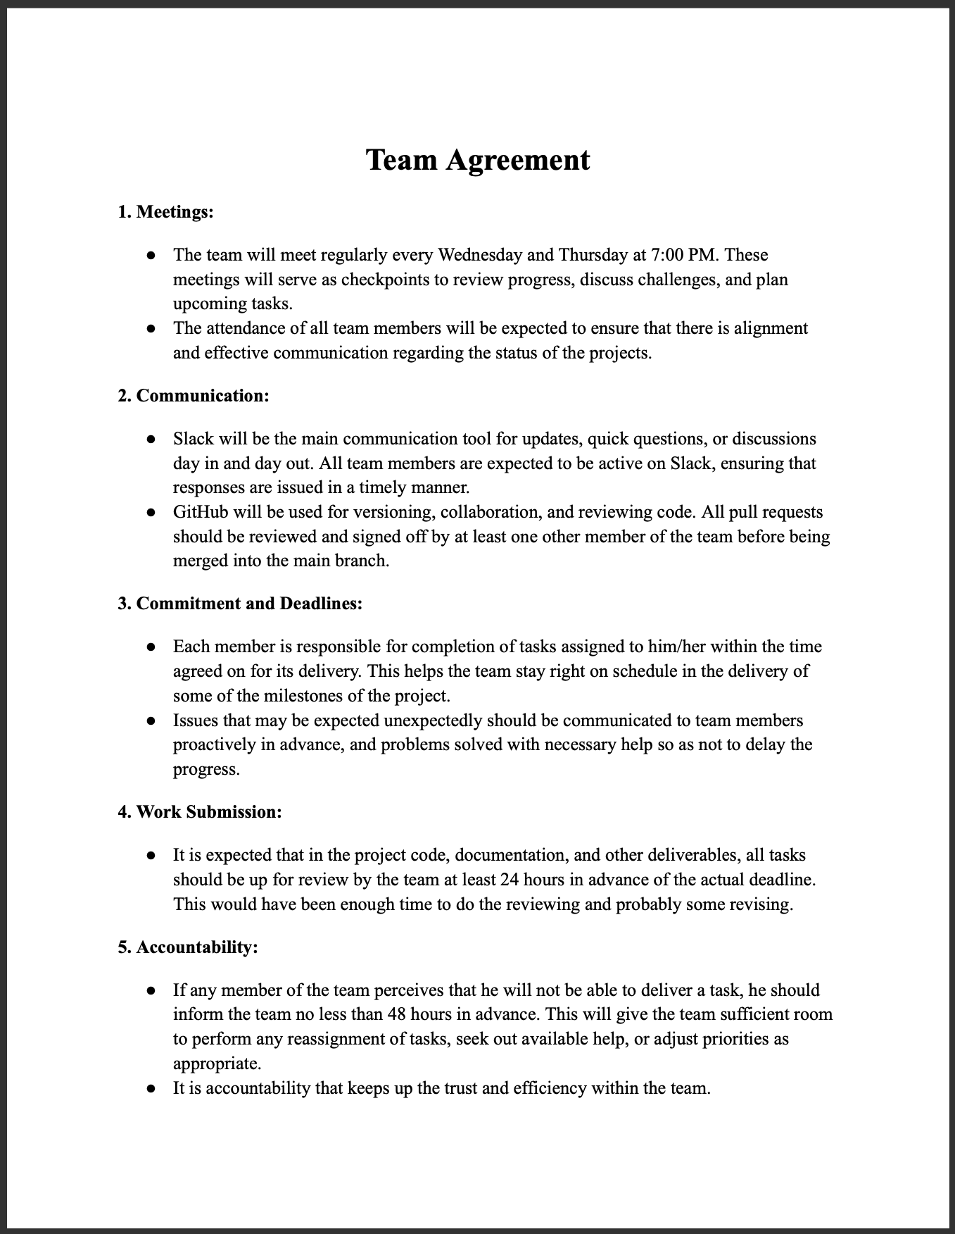
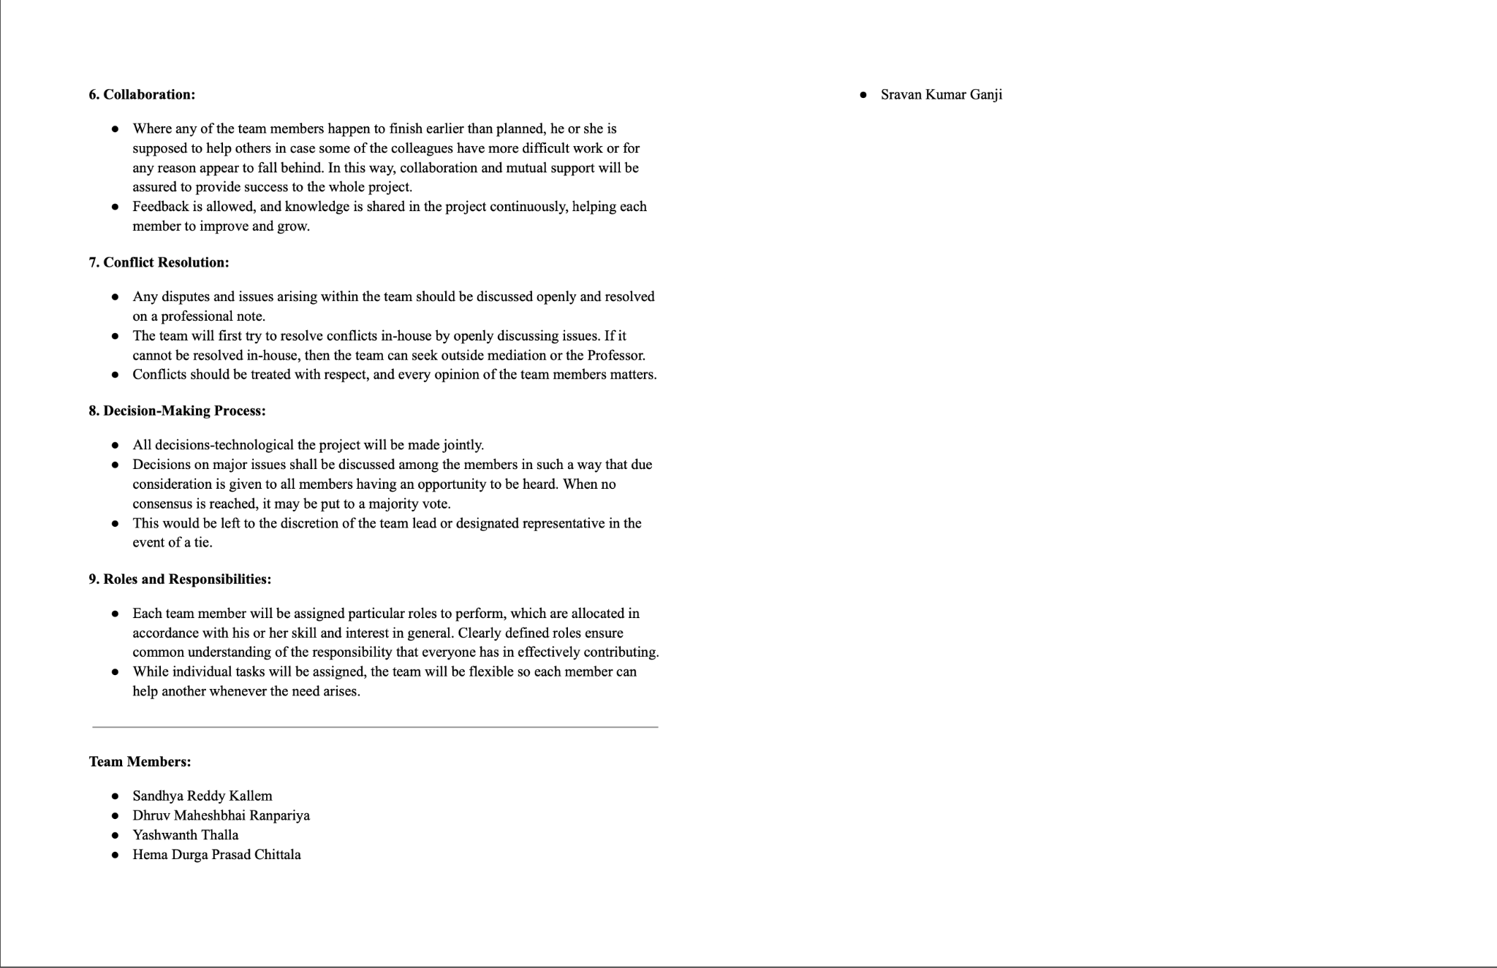
Team Agreement

Slide 9

Rajesh Verma (India)
Age: 35
Occupation: Software Engineer
Experience with Investing: 5 years
Location: Bengaluru, India
Investment Strategy: Rajesh focuses on Indian stocks with occasional investments in U.S. tech stocks. He uses fundamental analysis and stays updated through financial news. However, he struggles to keep up with the sheer volume of news and seeks AI-driven tools to help quickly evaluate relevant stock-related information.
Goal: To make faster, data-driven decisions on stock purchases or sales, particularly for his tech-heavy portfolio, while balancing his work schedule.

Slide 10

Elsa Thompson (United States)
Age: 28
Occupation: Financial Analyst
Experience with Investing: 7 years
Location: New York, USA
Investment Strategy: Elsa tracks market trends, particularly in the energy and healthcare sectors. She relies on research and sentiment data to make informed decisions but finds it challenging to manually sift through a large volume of news. She needs an AI-driven platform to prioritize relevant news efficiently.
Goal: To improve her efficiency in analyzing news to make informed recommendations to clients and colleagues, while staying ahead of fast-moving market trends.

Slide 11

Lucas Müller (Germany, Europe)
Age: 45
Occupation: Independent Investor & Trader
Experience with Investing: 15 years
Location: Munich, Germany
Investment Strategy: Lucas focuses on European and U.S. stock markets, relying on global news to inform his decisions. He’s interested in using AI tools to assess the impact of international news on specific stocks, aiming to automate part of his decision-making process and reduce emotional trading.
Goal: To leverage AI-driven sentiment analysis to enhance his stock trading strategies and make faster, more informed decisions, particularly when reacting to international news.

Slide 12
Minimum Viable Product
News Aggregation Fetch and display financial news articles from reputable sources through APIs.
Sentiment Analysis Analyze the sentiment of each news article (positive, neutral, negative) using a sentiment analysis tool.
Company Mention Detection Identify and highlight companies referenced in the news articles.
User Interface Present the news articles, sentiment scores, and impacted companies in a clean, intuitive interface.

Slide 13
Technologies
Backend
Frontend
Database
Flask, Express JS
ReactJS
MongoDB
Machine Learning
API
Cloud Hosting
PyTorch, Huggingface
NewsAPI
GCP

Slide 14


Backend
What is it?
How is it used?
Flask is a lightweight Python web framework, and Express JS is a fast and minimalist web framework for Node.js.
Flask or Express JS will be used to handle backend logic, manage API requests, and serve data between the frontend and the database, enabling communication between the sentiment analysis AI and the stock market news aggregator.

Slide 15

Frontend
What is it?
How is it used?
ReactJS is a popular JavaScript library for building interactive user interfaces.
ReactJS will be used to build the web application's dynamic and responsive frontend, allowing users to interact with the platform, view stock market news, and access AI-driven sentiment insights.

Slide 16

DATABASE
What is it?
How is it used?
MongoDB is a NoSQL database designed for flexibility and scalability, storing data in JSON-like documents.
MongoDB will store news articles, user preferences, and AI-generated sentiment analysis, enabling fast retrieval and updates as new data comes in from the API.

Slide 17

Machine learning
What is it?
How is it used?
PyTorch is a machine learning framework, and Huggingface is a platform that provides pre-trained models and tools for NLP tasks.
PyTorch and Huggingface will be used to develop and deploy sentiment analysis models that process stock market news and classify the sentiment of each article (positive, neutral, or negative).

Slide 18
API
What is it?
How is it used?
NewsAPI is a service that provides access to news articles from various sources around the world.
NewsAPI will be integrated into the backend to pull relevant stock market news articles, which will be processed by the sentiment analysis model before being displayed to users.

Slide 19

Cloud Hosting
What is it?
How is it used?
Google Cloud Platform is a suite of cloud computing services that provides infrastructure for hosting applications.
GCP will host the web application, manage the backend servers, store data, and provide the resources necessary for running the machine learning models and API integrations efficiently.

Slide 20
Algorithm
What is BERT?
In what way is it applied?
BERT is an advanced Natural Language Processing (NLP) model developed by Google. It is formulated on the Transformer architecture and is devised to comprehend the context of a word in a sentence by studying it in both directions—left and right from the word—thus, it is very useful for sentiment analysis tasks, for example, understanding the sentiment of the text.
In the context of your project, BERT can be utilized through Huggingface to analyze stock market news articles and perform sentiment analysis. It will monitor the text and determine the sentiment(s) expressed in the news as positive, neutral, or negative. Therefore the technology enabling the categorization of each news piece and, consequently the provision of sentiment insights to the investors that quick assess of how the news may impact the stock performance. BERT's success in learning complex language patterns makes sentiment analysis more precise, which gives a more well-founded recommendation compared to the traditional NLP models.

Slide 21
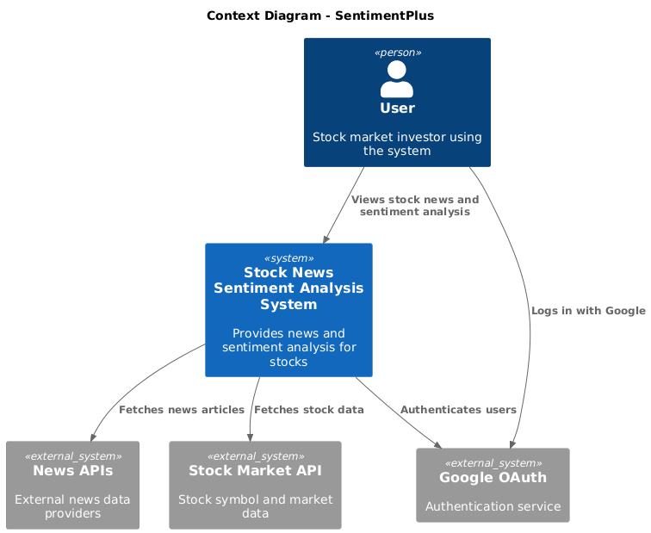
Context Diagram

Slide 22
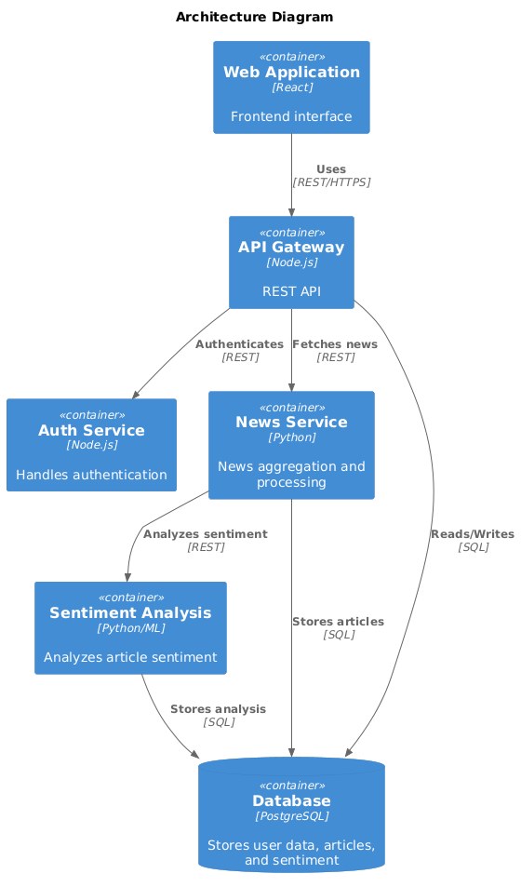
Architecture Diagram

Slide 23
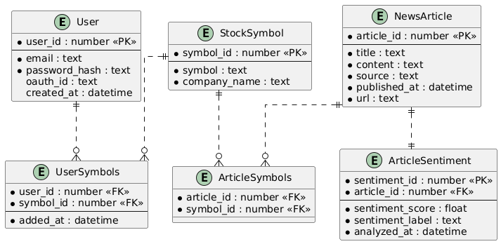
ER Diagram

Slide 24
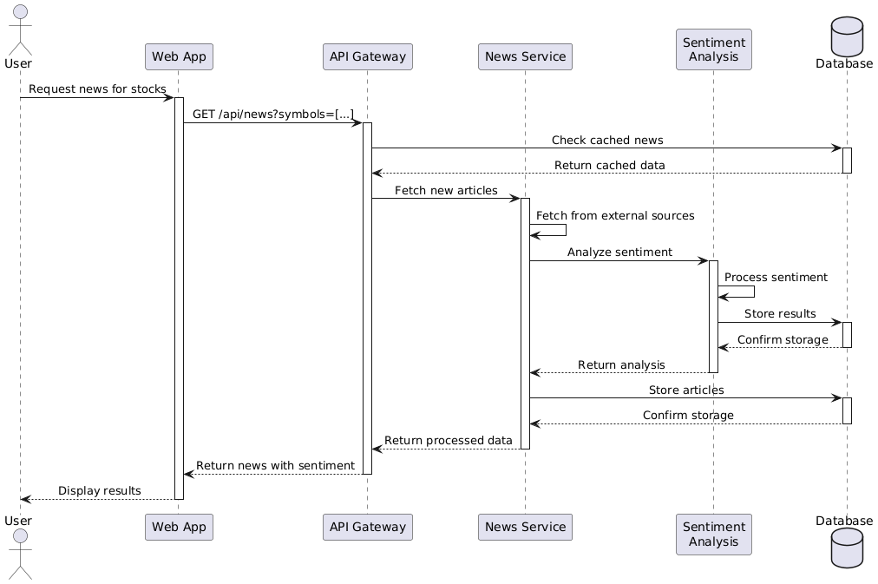
Sequence Diagram

Slide 25
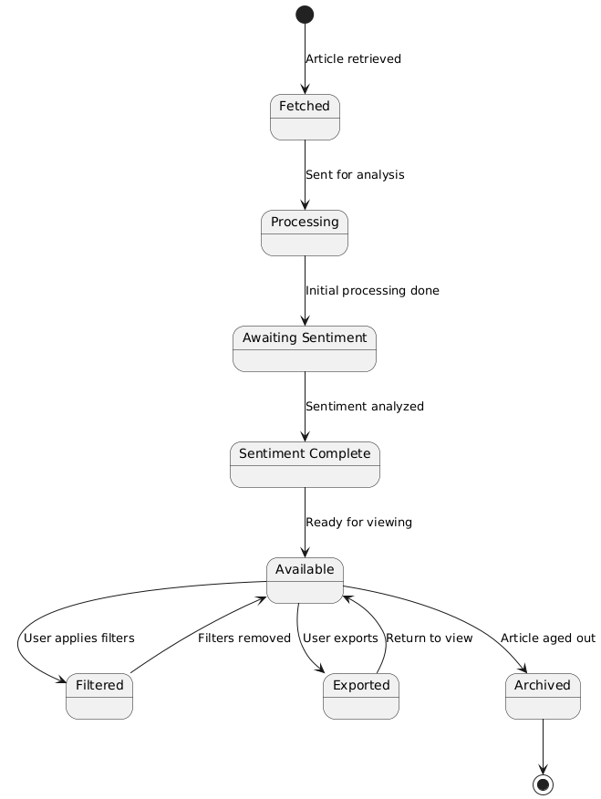
State Diagram

Slide 26
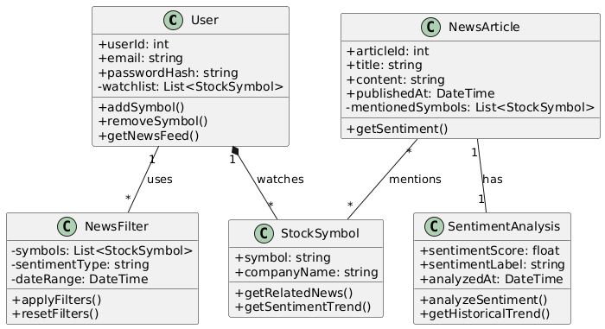
Class Diagram

Slide 27
Product Backlog
Sno | Sprint | User Story / Task | Description | Acceptance Criteria
1 | Sprint 1 | User Story | As a user, I want to input stock symbols of interest so I can receive relevant news articles. | Users can search and input stock symbols. Stock symbols stored and shown on dashboard.
2 | Sprint 1 | User Story | As a user, I want to see a list of news articles related to stock symbols I've selected. | Articles are filtered by stock symbols. News displayed in chronological order.
3 | Sprint 1 | User Story | As a user, I want to filter news articles by relevance to my stock symbols so that I can focus on the most important articles. | News ranked by relevance to stock symbols. Filter option for relevant articles only.
4 | Sprint 1 | Technical Task | Set up backend infrastructure for news aggregation and stock symbol search. | API fetches news from 3 sources. Backend handles stock searches and storage.
5 | Sprint 1 | Technical Task | Establish database structure for user profiles, stock symbols, and news articles. | Create tables for users, symbols, articles. Ensure user-stock preferences are linked.

Slide 28
Product Backlog
Sno | Sprint | User Story / Task | Description | Acceptance Criteria
6 | Sprint 2 | User Story | As a user, I want to log in securely so that I can access personalized sentiment analysis. | Users log in with email/password. Support Google OAuth login.
7 | Sprint 2 | User Story | As a user, I want each news article to display a sentiment rating so that I can gauge its emotional tone (positive, negative, neutral). | Sentiment rating visible for each article. Sentiment rating is easy to understand.
8 | Sprint 2 | User Story | As a user, I want to filter news articles by sentiment so that I can focus on specific sentiment types (e.g., only positive news). | Filter by positive, negative, neutral. Dynamic UI update when filtering.
9 | Sprint 2 | Technical Task | Integrate AI sentiment analysis engine for news articles. | AI assigns sentiment to articles. AI achieves 80% accuracy or higher.
10 | Sprint 2 | Technical Task | Develop user authentication system (login and OAuth). | Implement login with email/password. Add OAuth for social logins.

Slide 29
Product Backlog
Sno | Sprint | User Story / Task | Description | Acceptance Criteria
11 | Sprint 2 | Technical Task | Connect backend to sentiment analysis model. | API connects backend to sentiment model. Ensure real-time sentiment processing.
12 | Sprint 3 | User Story | As a user, I want to filter articles based on both stock symbols and sentiment so I can focus on the best insights for my trading decisions. | Apply filters for symbols and sentiment. Filtered news updates in real time.
13 | Sprint 3 | User Story | As a user, I want to export the sentiment analysis and news data to a CSV file so I can analyze it offline. | Provide option to export data to CSV. Export includes stock, sentiment, and news.
14 | Sprint 3 | User Story | As a user, I want to view historical sentiment trends for a particular stock symbol so I can analyze long-term market sentiment. | Sentiment trends shown graphically. View trends for different time periods.
15 | Sprint 3 | User Story | As a user, I want to reset all filters easily so I can return to the full, unfiltered news feed. | Provide a clear option to reset filters. Reset clears all active filters.

Slide 30
Product Backlog
Sno | Sprint | User Story / Task | Description | Acceptance Criteria
16 | Sprint 3 | Technical Task | Implement historical sentiment tracking and visualization. | Track and store historical sentiment. Display trends using a graph.
17 | Sprint 3 | Technical Task | Improve frontend performance and responsiveness. | Optimize UI for mobile and desktop. Ensure fast filter application.

Slide 31
Sprint 1 Backlog
User Story / Task | Description | Acceptance Criteria | Story Points
User Story | As a user, I want to input stock symbols of interest so I can receive relevant news articles. | - Users can search and input stock symbols. - Stock symbols stored and shown on dashboard. | 5 Points
User Story | As a user, I want to see a list of news articles related to stock symbols I've selected. | - Articles are filtered by stock symbols. - News displayed in chronological order. | 8 Points
User Story | As a user, I want to filter news articles by relevance to my stock symbols so that I can focus on the most important articles. | - News ranked by relevance to stock symbols. - Filter option for relevant articles only. | 5 Points
Technical Task | Set up backend infrastructure for news aggregation and stock symbol search. | - API fetches news from 3 sources. - Backend handles stock searches and storage. | 8 Points
Technical Task | Establish database structure for user profiles, stock symbols, and news articles. | - Create tables for users, symbols, articles. - Ensure user-stock preferences are linked. | 5 Points
Total 31 Points

Slide 32
Test Cases
Test Case ID | Story/Task | Test Case Description | Expected Result | Actual Result | Pass/Fail
TC-1.1 | User Story 1 | Verify users can input stock symbols. | Stock symbols can be entered. | Stock symbols entered successfully. | Pass
TC-1.2 | User Story 1 | Verify system shows suggestions as users type stock symbols. | Stock suggestions appear as user types. | Suggestions displayed for relevant symbols. | Pass
TC-1.3 | User Story 1 | Verify stock symbols are stored and displayed on the dashboard. | Stock symbols are visible on the dashboard. | Stock symbols displayed correctly. | Pass
TC-2.1 | User Story 2 | Verify news articles are filtered by selected stock symbols. | Articles are filtered by selected stock symbols. | Articles not filtered properly. | Pass
TC-2.2 | User Story 2 | Verify articles are displayed in chronological order. | News articles appear in chronological order. | Chronological order not working. | Pass

Slide 33
Test Cases
Test Case ID | Story/Task | Test Case Description | Expected Result | Actual Result | Pass/Fail
TC-3.1 | User Story 3 | Verify news articles are ranked based on relevance to stock symbols. | Articles are ranked based on relevance. | Ranking algorithm needs optimization. | Pass
TC-3.2 | User Story 3 | Verify the relevance filter displays only relevant articles. | Only relevant articles are displayed. | Irrelevant articles also displayed. | Pass
TC-4.1 | Technical Task 1 | Verify API fetches news from all 3 sources. | News fetched from all 3 sources. | API failed to fetch from one source. | Pass
TC-4.2 | Technical Task 1 | Verify backend stores and retrieves stock symbol data. | Stock symbol data stored and retrieved correctly. | Stock data stored and retrieved successfully. | Pass
TC-5.1 | Technical Task 2 | Verify tables for user profiles, stock symbols, and articles are created. | Tables for users, symbols, articles created. | Tables created successfully. | Pass

Slide 34
Stories Completed
Completed Stories/Tasks | Description
User Story 1 | Stock symbol input, suggestions, and display functionalities are completed.
User Story 2 | News articles filtered by stock symbols and displayed in chronological order are completed.
User Story 3 | Relevance-based filtering of news articles is completed.
Technical Task 1 | Backend infrastructure for news aggregation from 3 sources is set up and functional.
Technical Task 2 | Database structure for users, stock symbols, and articles is established, and relationships are working correctly.

Slide 35
Team Velocity - This Sprint
Total Story Points Completed: 31 points

Slide 36
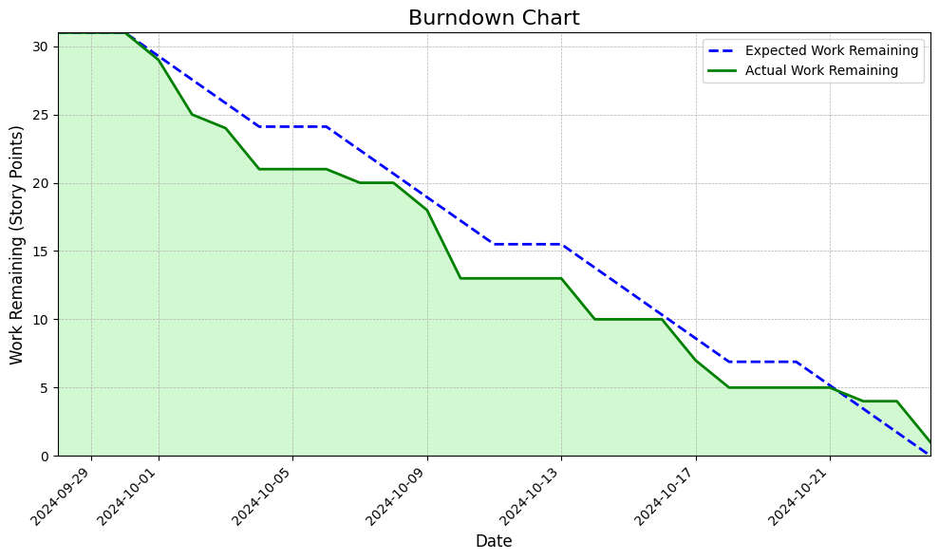
Burndown Chart

Slide 37
Completed/Committed Ratio
Story Points Committed: 31 points
Story Points Completed: 31 points
Completed/Committed Ratio: 100%

Slide 38
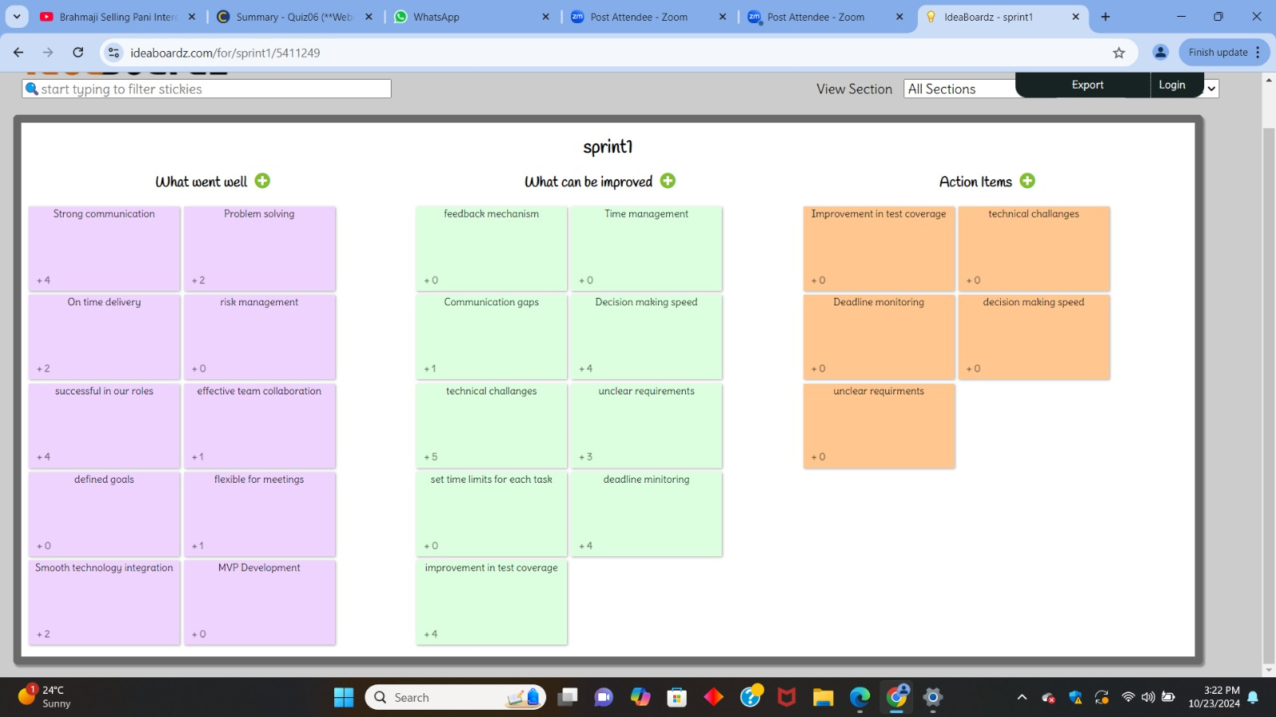
Retrospective

Slide 39
Sprint 2 Backlog
Sno | Sprint | User Story / Task | Description | Story Points
6 | Sprint 2 | User Story | As a user, I want to log in securely so that I can access personalized sentiment analysis. | 8 points
7 | Sprint 2 | User Story | As a user, I want each news article to display a sentiment rating so that I can gauge its emotional tone (positive, negative, neutral). | 13 points
8 | Sprint 2 | User Story | As a user, I want to filter news articles by sentiment so that I can focus on specific sentiment types (e.g., only positive news). | 5 points
9 | Sprint 2 | Technical Task | Integrate AI sentiment analysis engine for news articles. | 8 points
10 | Sprint 2 | Technical Task | Develop user authentication system (login and OAuth). | 13 points

Slide 40
Sprint 2 Backlog
Sno | Sprint | User Story / Task | Description | Story Points
11 | Sprint 2 | Technical Task | Connect backend to sentiment analysis model. | 3 Points

Slide 41
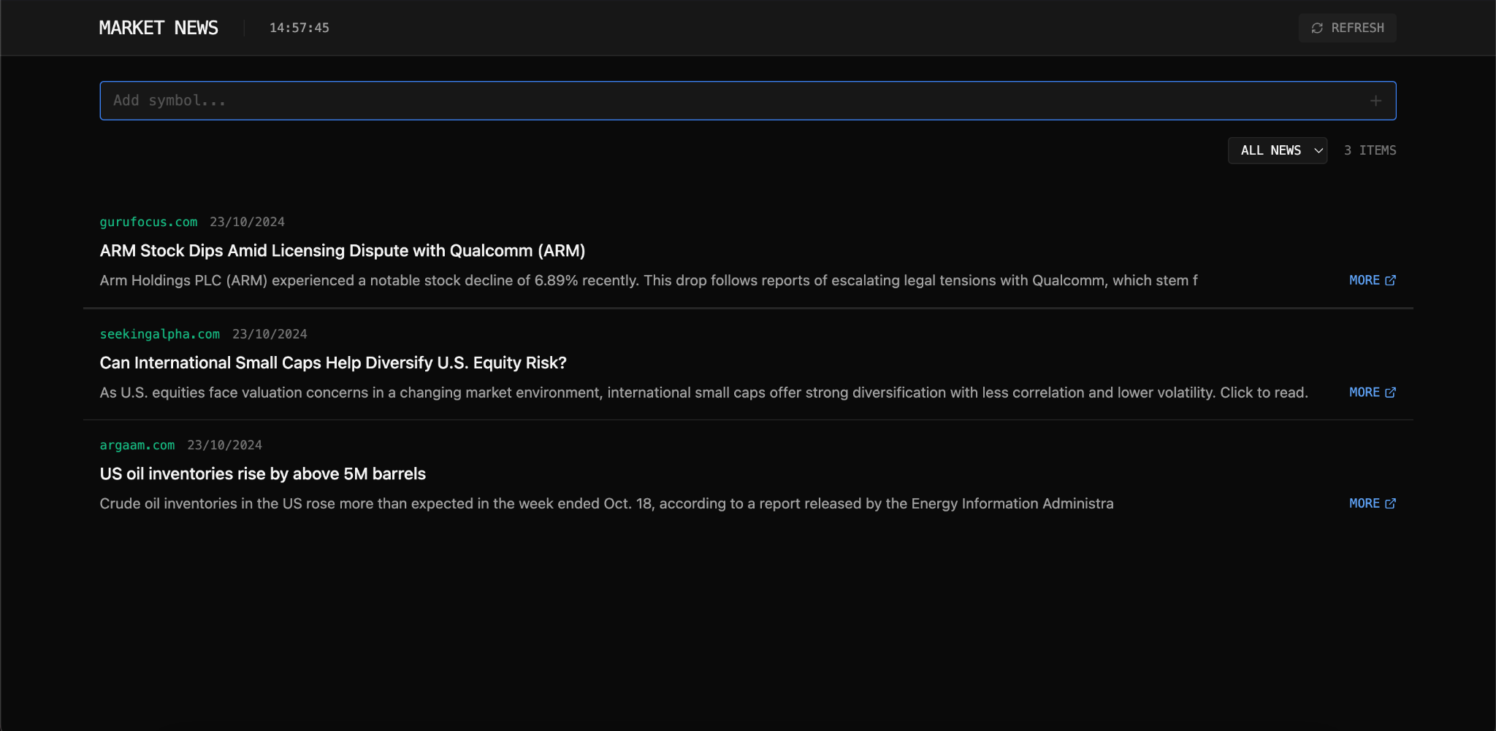
App Screenshot

Slide 42
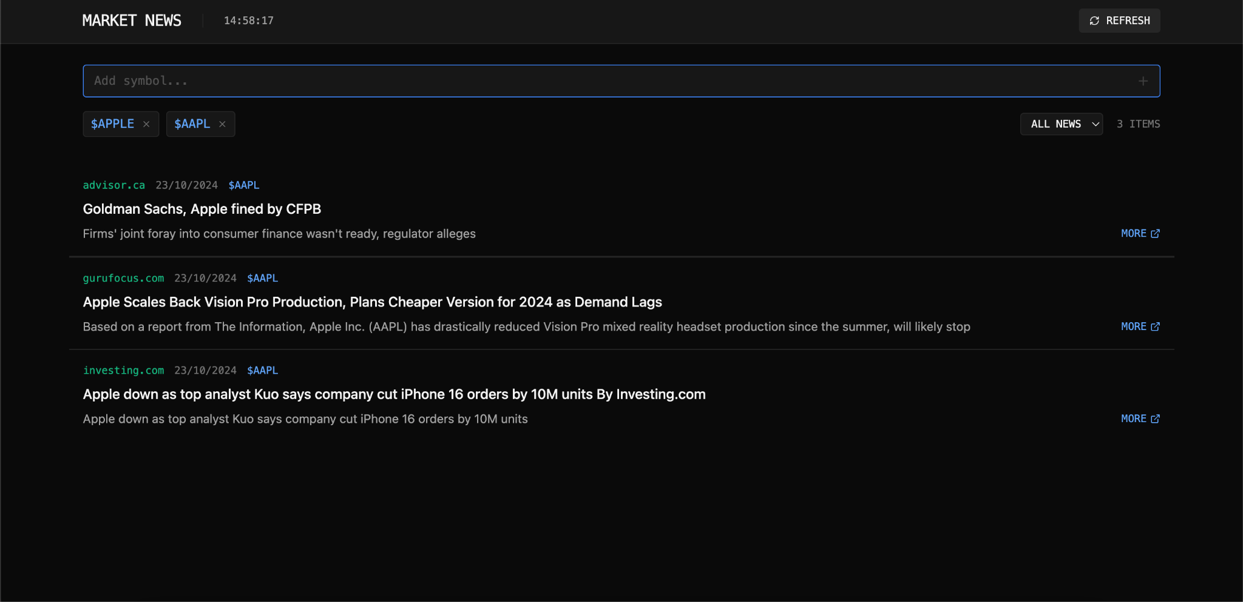
App Screenshot

Slide 43
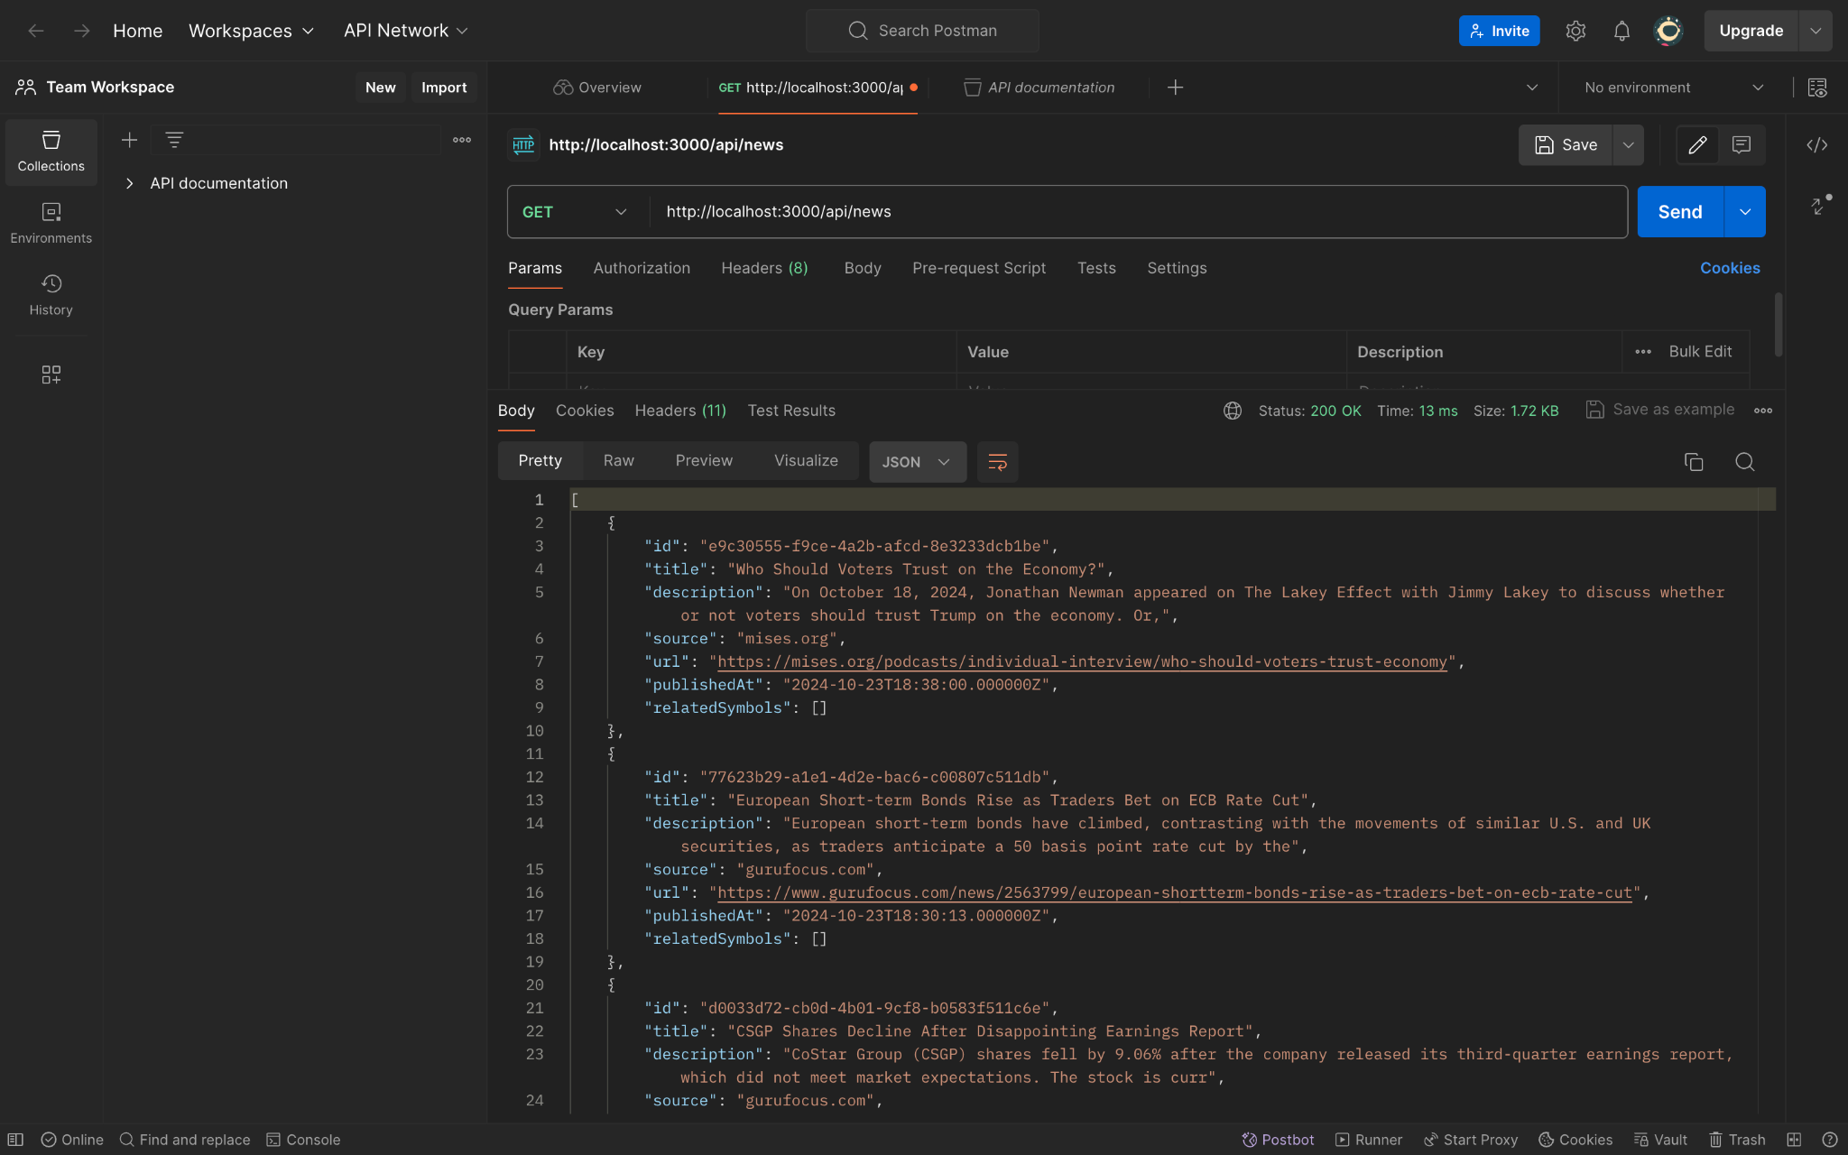
API

Slide 44
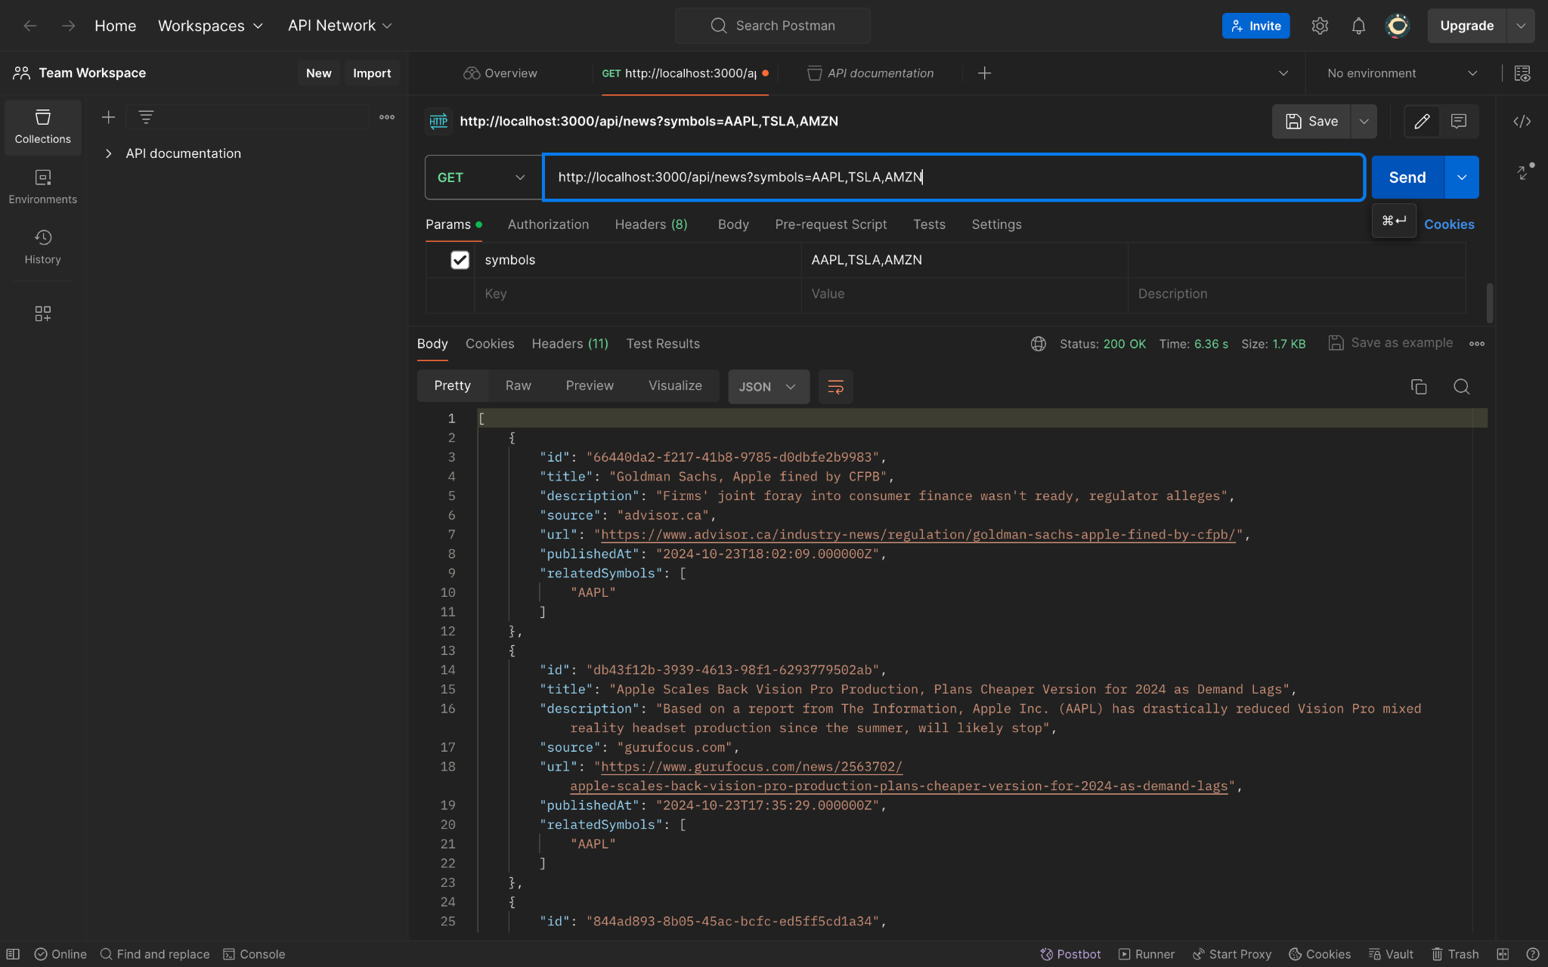
API

Slide 45
WikiPage
https://github.com/htmw/2024F-Team-Spirit/wiki

Slide 46
Application Demo
LIVE

Slide 47
Thank you

